Slide 1
Monolith
Tier
Microservice
SQL
ANSI: American National Standard Institute
TSQL
PG/PLSQL -
PostgreSQL
Repeatable Read
Memcached
Redis

Slide 2
a*b
A-b*a^b+b

Slide 3
Backends
Connection pooling
VIP solution
Watchdog (etcd, zookeeper, /dev/watchdog, pgpool) WSFC
Caching (memcached)

Slide 4
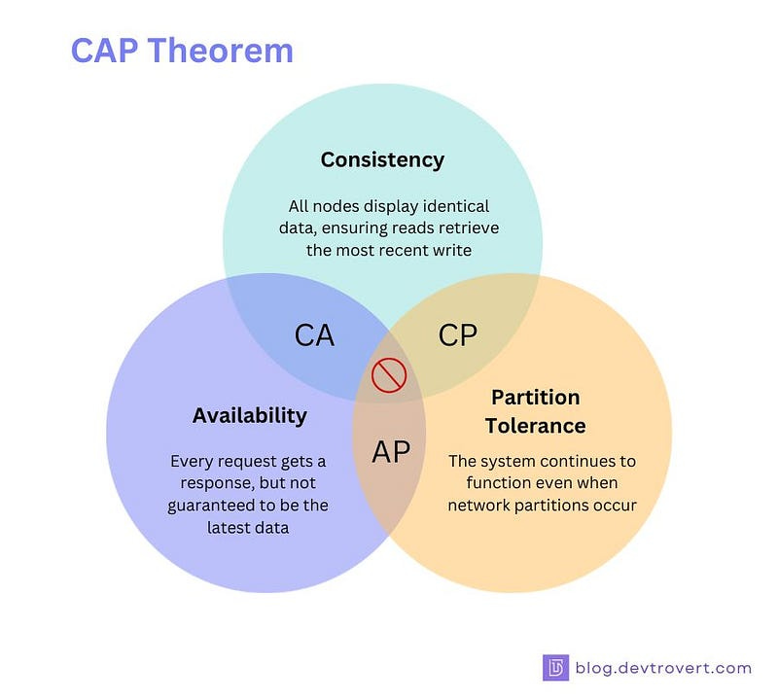


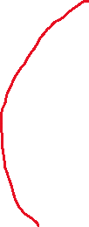
This is where CockroachDB comes from

Slide 5
CockroachDB (Distributed RDBMS)
MultiActive
192.168.171.71
192.168.171.75
192.168.171.73
192.168.171.72

Slide 6
Windows Subsystem for Linux
Version 2
Debian:
Ubuntu-kubuntu-Zorin-Kali
RHEL:
CentOS-Rocky Linux-Fedora
Container:
Docker

Slide 7
Telnet
SSH
Secure Shell

